Slide 1
FHIR
For CMS
Grahame Grieve
Feb 23, 2014

Slide 2
Who am I?
Name: Grahame Grieve
Company: Health Intersections Pty Ltd
Background:
Laboratory Scientist / Medical Research
Diagnostic Systems Vendor
Health Integration / Standards
FHIR Project Lead
Blog: http://healthintersections.com.au

Slide 3
What is FHIR?

Slide 4

Answer: An instigator of bad puns
Fast Health Interoperable Resources
FHIR is the hottest thing since . . .
This spec is spreading like . . .
Committee X is really on FHIR

Slide 5
Genesis of FHIR
Has been a need to share healthcare information electronically for a long time
HL7 v2 is over 25 years old
Increasing pressure to broaden scope of sharing
Across organizations, disciplines, even borders
Mobile & cloud-based applications
Faster – integration in days or weeks, not months or years
Notes:
Who

Slide 6
Genesis of FHIR
Q: So what did HL7 have to offer in this space?
A: Not much
V2 Old, and limited by it’s own rules
V3 too much internal complexity
Different contexts of interoperability → different representations that aren’t compatible
Nothing suitable for light-weight integration, or for Health 2.0

Slide 7

Genesis of FHIR
HL7 undertook a “Fresh look”
What would healthcare exchange look like if we started from scratch using modern approaches?
Web search for success markers led to RESTful based APIs
Exemplar: Highrise (https://github.com/37signals/highrise-api)
Drafted a healthcare exchange API based on this approach

Slide 8
FHIR Development Progress
July 2011 – Conception
Aug/Sept 2012 – First Draft Ballot
Sept 2012 – First Connectathon
Aug/Sept 2013 (now) – First DSTU ballot DSTU = Draft Standard For Trial Use
January 2014 – DSTU finalised
~July 2015 – 2nd DSTU
2017? – Normative Version

Slide 9
FHIR Principles

Slide 10
FHIR Manifesto
FHIR is platform for innovation
Focus on Implementers
Target support for common scenarios
Leverage cross-industry web technologies
Require human readability as base level of interoperability
Make content freely available
Support multiple paradigms & architectures
Notes:
We don’t actually have a formal manifesto, but these are the principles we adhere to.

Slide 11
Problems we face
No central authorities
Permutation of biological and sociological complexity
Fractal use cases
Economics favours balkinization
Externalizing complexity
Much confusion about the problem

Slide 12
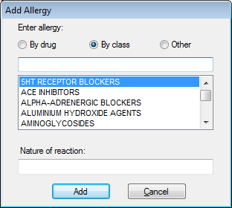
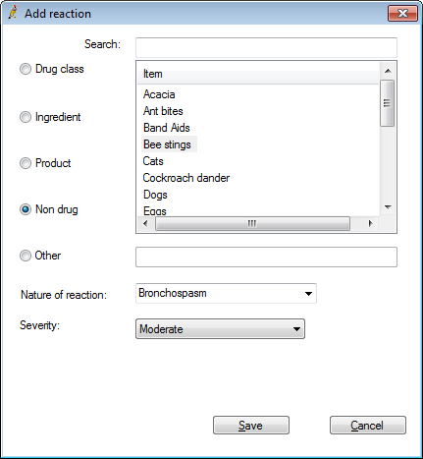
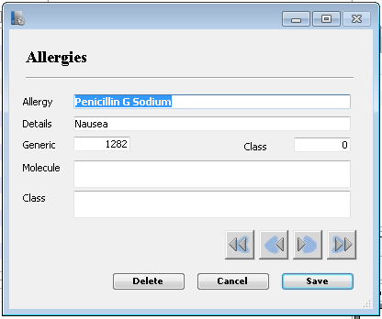
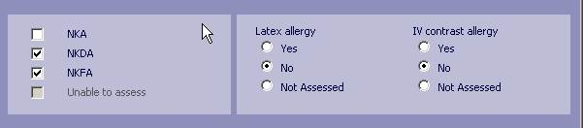

Slide 13
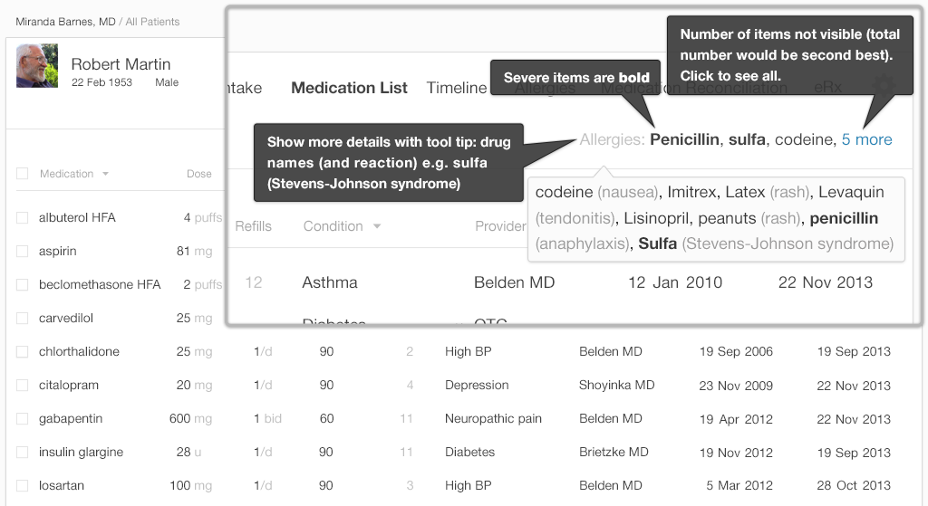
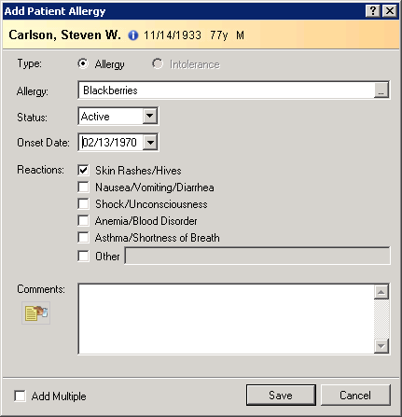

Slide 14
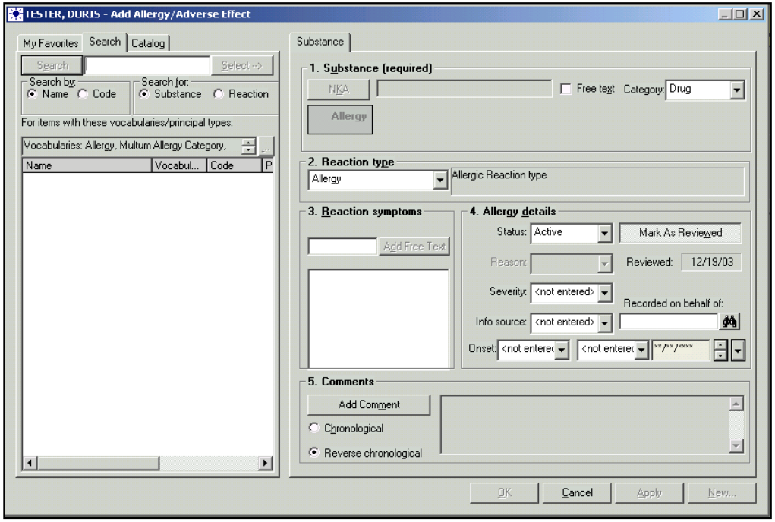

Slide 15
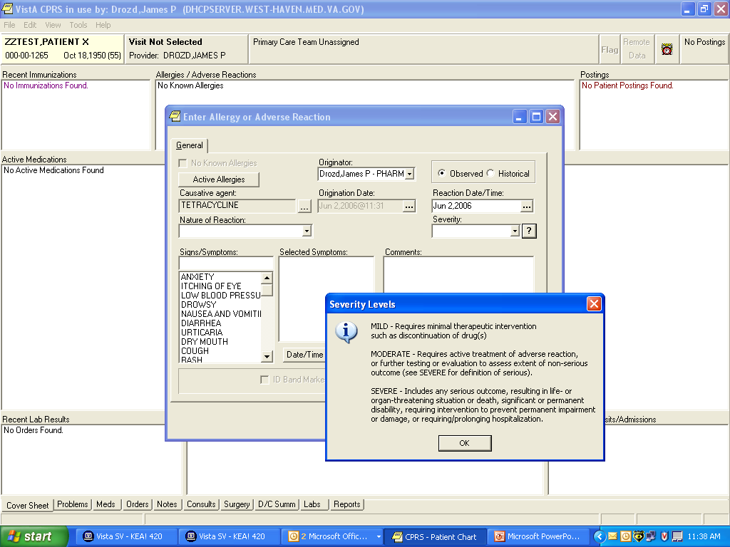

Slide 16
Sources of Complexity
Inherent in problem & description
business variability between instances
incompetence / inappropriate solutions

Slide 17
Complexity Model
Snomed
HL7 V3
openEHR
WS
CDA
Difficulty (log)
XML
HL7 v2
How?
HTTP / HTML
Text
Semantic Depth

Slide 18
Three Laws of Interoperability
Interoperability: It’s all about the people
You can hide the complexity, or make it worse, but you can’t make it go away
Cheap, flexible, and interoperable: when developing healthcare software, you can have two of these
Notes:
Disagreement
Average cost of existence
Examples
Qualifications – not quite true

Slide 19
Platform for Interoperability
Build capability for all systems
Only fix behavior
When everyone agrees to it
When it creates capability or simplicity
Push constraints on behavior to “Implementation Guides”
FHIR is loose, but capable
Implementation space will be fractal ☹

Slide 20
Implementer Focus
Specification is written for one target audience: implementers (that’s not just programmers)
Rationale, modeling approaches, etc. kept elsewhere
Multiple reference implementations from day 1
Publicly available test servers
Starter APIs published with spec
C#, Java, Pascal, Swift – more to come
Connectathons to verify specification approaches
Instances you can read and understand ☺
Lots of examples (and they’re valid too)
using HL7.Fhir.Instance.Model;
using HL7.Fhir.Instance.Parsers;
using HL7.Fhir.Instance.Support;
XmlReader xr = XmlReader.Create(
new StreamRead
IFhirReader r = new XmlFhirReader
// JsonTextReader jr = new JsonTe
// new StreamRead
// IFhirReader r = new JsonFhirRe
ErrorList errors = new ErrorList(
LabReport rep = (LabReport)Resour
Assert.IsTrue(errors.Count() == 0
Notes:
Who’s read the v3 spec? – modeler & balloter focused
Spec is driven by people who write code
Numerous pieces have been changed because of experience with what worked when trying to implement
Even have a test workbench for RESTful servers

Slide 21
Support “Common” Scenarios
Focus on scenarios implementers ask for
Inclusion of content in core specification is based on core content rule
“We only include data elements if we are confident that most normal implementations using that resource will make use of the element”
Other content in extensions (more on this later)
Easy to say, governance challenge to achieve
Resources are simple and easy to understand and use
Notes:
Design by constraint failed – years to develop, what was produced required yet more design to be implementable and after that might not be interoperable
How to determine the 80%? Look to existing specs – v2, v3, CDA templates, OpenEHR, jurisdictional projects, what implementations we’ve seen
If not sure, err on the side of “not in for now”
Note: not 80% of instances, 80% of implementations
Challenges with “raising the bar”
What happens when there aren’t many/any implementations?

Slide 22
Web technologies
Instances shared using XML & JSON
Use W3C / IETF standards where possibe
Web calls work the same way they do for Facebook & Twitter
Rely on HTTPS, OAuth, etc. for security functions
http://...
Notes:
We try very hard to *not* invent stuff that exists elsewhere unless it’s really broken or totally unaligned with the FHIR principles.

Slide 23

Human Readable
Clinical Documents has both narrative and data
The data / narrative dynamic exists throughout the process
In FHIR, every resource can (should) have a human-readable expression
Can be direct rendering or human entered
Notes:
Even when you think your target will understand all the encoded data, reality is data often gets shared beyond the originally intended context
Allow for exceptions for things like automated device readings, etc.

Slide 24
Freely available
Unencumbered – free for use, no membership required
http://hl7.org/fhir + other versions
Licensed under CC0: True public domain
Any use is allowed
HL7 enforces the trademark protection
Notes:
Was a bigger deal before HL7 decided to open up all IP
full legal text towards bottom of FHIR home page

Slide 25
FHIR & Cost of Integration
These factors will drive down the cost of integration and interoperability
Easier to Develop
Easier to Troubleshoot
Easier to Leverage in production
More people to do the work (less expensive consultants)
Competing approaches will have to match the cost, or disappear – effect is already being felt

Slide 26
Future impact of FHIR
Impact of FHIR on the market:
Drive interoperability prices down
Higher Expectations
Increased spend on integration (N x 2!)
Overall Market focus
PHR on the web
Healthcare repositories (MHD+)
Device Data management
Retooling existing connections
Notes:
How much integration do you need? Nx2 – twice what you have

Slide 27
FHIR OVERVIEW

Slide 28
Paradigms
FHIR supports 4 interoperability paradigms
REST
Documents
Messages
Services

Slide 29
RESTful
Base FHIR spec is designed around RESTful principles
Resources / Representation (JSON / XML)
Read/Search/Create/Update/Delete + Batch / Transaction
Operations
OAuth etc for security
Requires trusted clients
Notes:
Delete isn’t necessarily physical

Slide 30
Messages
Some implementations can’t use REST
National programs, pre-existing architectural investment
Package resources into a bundle and send as coarse grained transactions
Event-driven
E.g. Send lab order, get back result
Can be asynchronous
Messages

Slide 31
Documents
Similar to CCDA (Meaningful Use)
Collection of resources bound together
Root is a “Composition” resource
Just like CDA header
A bundle
Composition gives context
Can be signed, authenticated, etc.
CDA v3 based on FHIR (probably)
Documents

Slide 32
Service Oriented Architecture (SOA)
Do whatever you like
(based on SOA principles)
Ultra complex workflows
Ultra simple workflows
Individual resources or collections
Use HTTP or use something else
Only constraint is that you’re passing around FHIR resources in some shape or manner
Services
Notes:
Comment about SOA discovery day

Slide 33
Paradigms
Regardless of paradigm the content is the same
This means it’s straight-forward to share content across paradigms
E.g. Receive a lab result in a message. Package it in a discharge summary document
It also means constraints can be shared across paradigms
E.g. Define a profile for Blood Pressure and use it on resources in messages, documents, REST and services

Slide 34

Resources
“Resources” are:
Small logically discrete units of exchange
Defined behaviour and meaning
Known identity / location
Smallest unit of transaction
“of interest” to healthcare

Slide 35
FHIR Resource URLs
Template | Description | Example | Operations
[base] | Server URL | http://fhir.com | OPTIONS, POST
[base]/[type] | Collection Manager | http://fhir.com/Patient | GET, POST
[base]/[type]/[id] | URL for a resource | http://fhir.com/Patient /23 | GET, PUT, DELETE
[base]/[type]/[id]/$[name] | Operation (server action) | http://fhir.com/Patient /23/$everything | POST
[base]/[type]/[id]/_history/[vid] | Past version | http://fhir.com/Patient/23/_histroy/2 | GET

Slide 36
What’s a Resource?
Examples
Non-examples
Administrative
Patient, Practitioner, Organization, Location, Coverage, Invoice
Clinical Concepts
Allergy, Condition, Family History, Care Plan
Infrastructure
Document, Message, Profile, Conformance
Gender
Too small
Electronic Health Record
Too big
Blood Pressure
Too specific
Intervention
Too broad
100-150 total
Notes:
And few systems will ever see more than 40-50

Slide 37
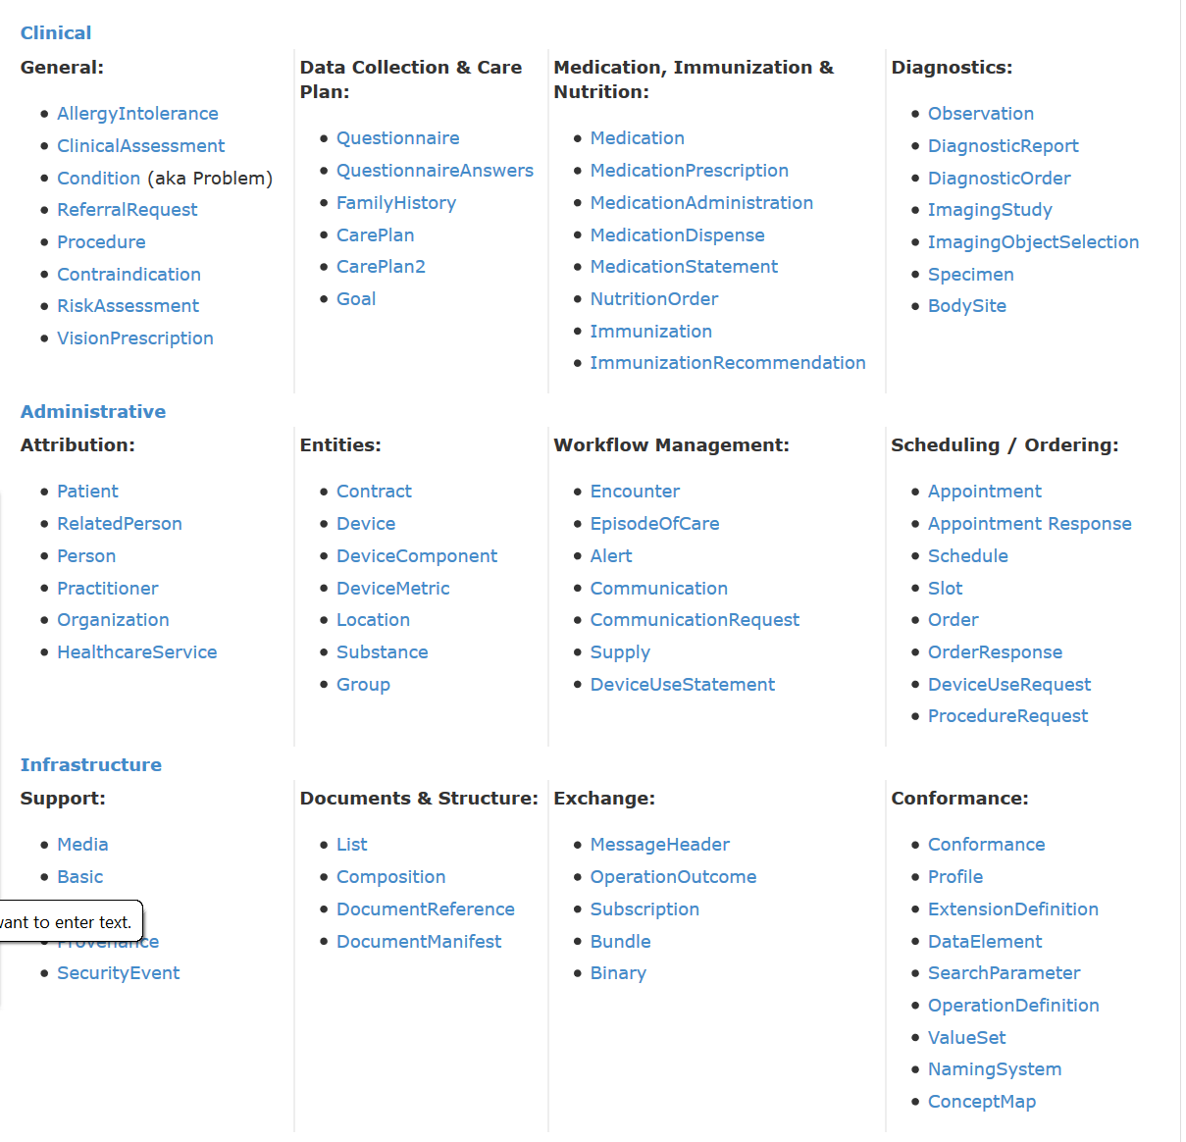
DSTU Resource List

Slide 38
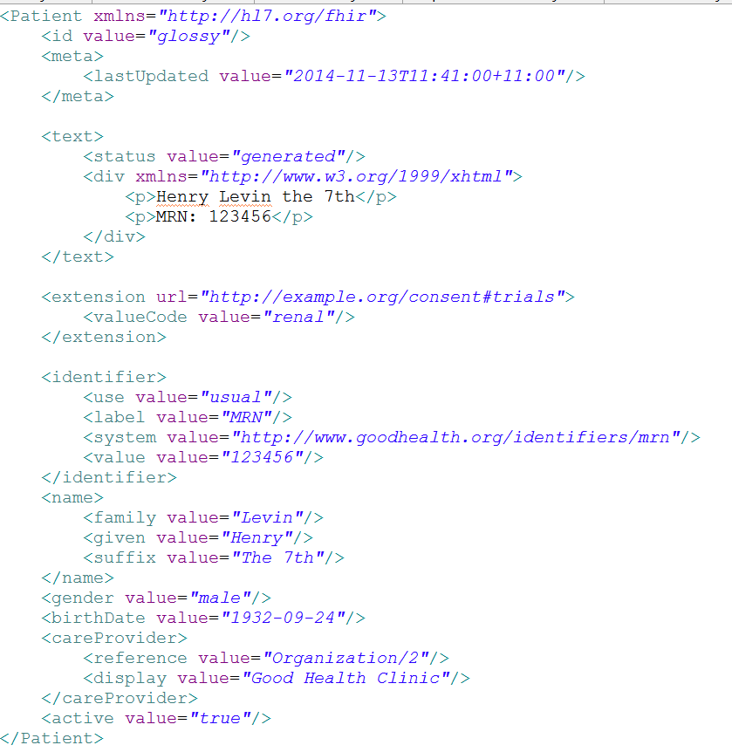
Identity & Metadata
Human Readable Summary
Extension with reference to its definition
Standard Data Content:
MRN
Name
Gender
Date of Birth
Provider
Notes:
System for gender is wrong . . .

Slide 39
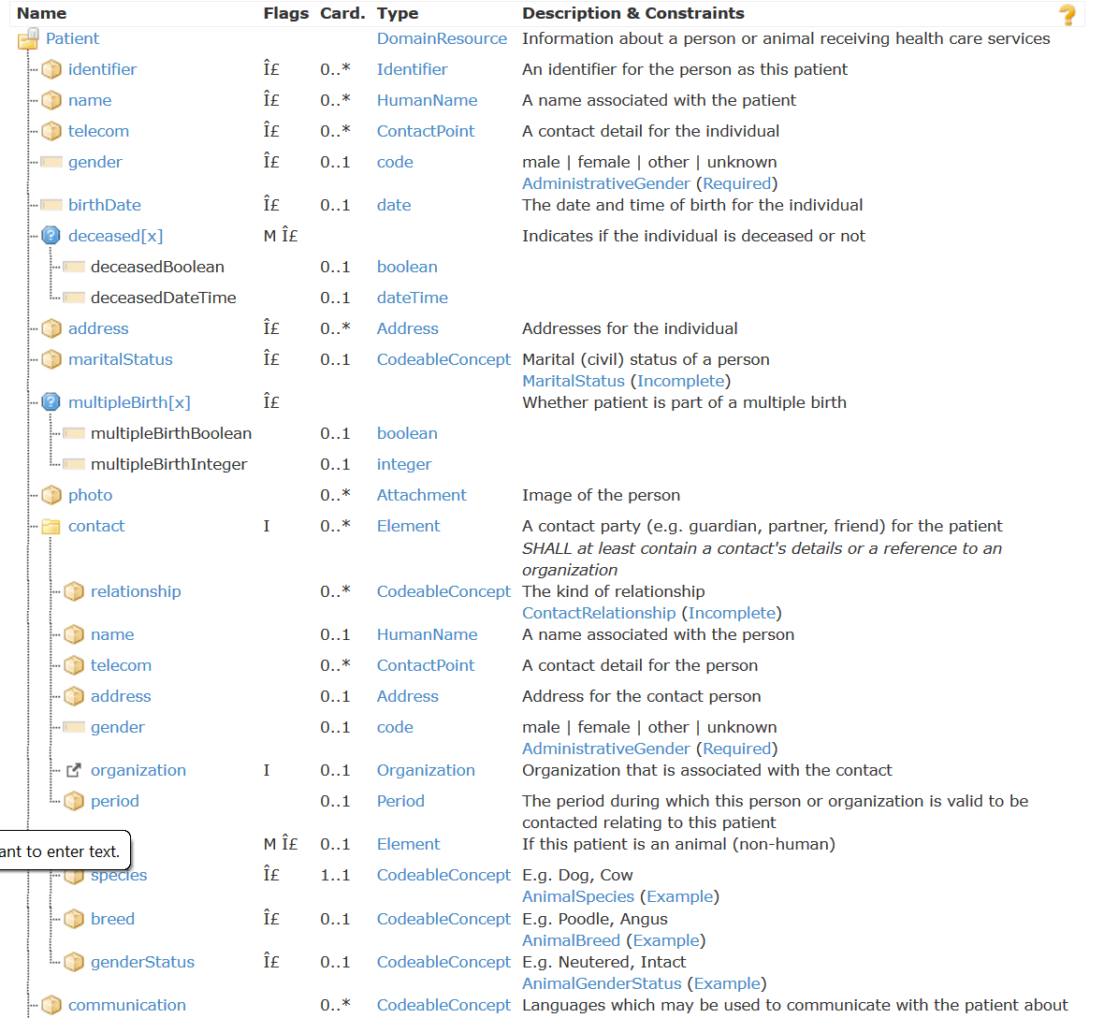
Resource Definitions

Slide 40
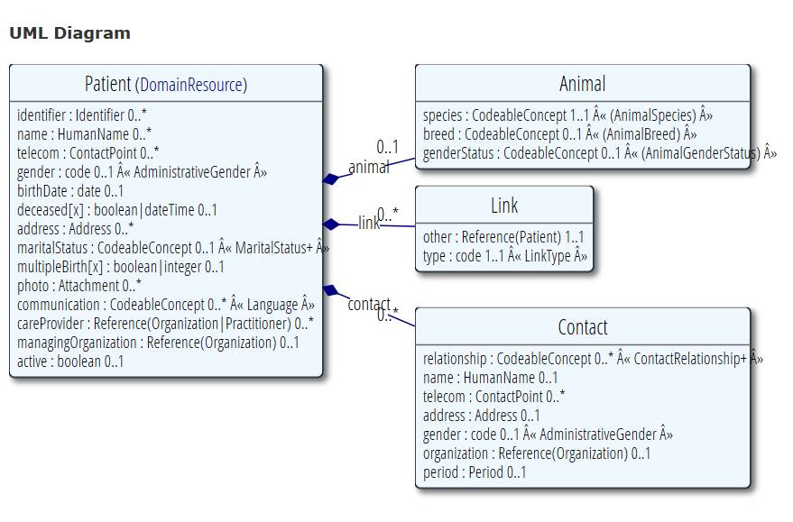
Resource Definitions

Slide 41
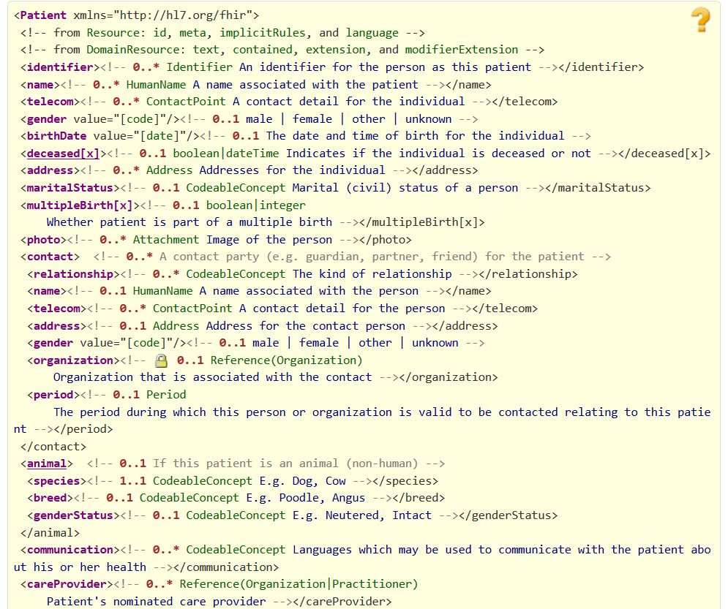
Resource Definitions

Slide 42
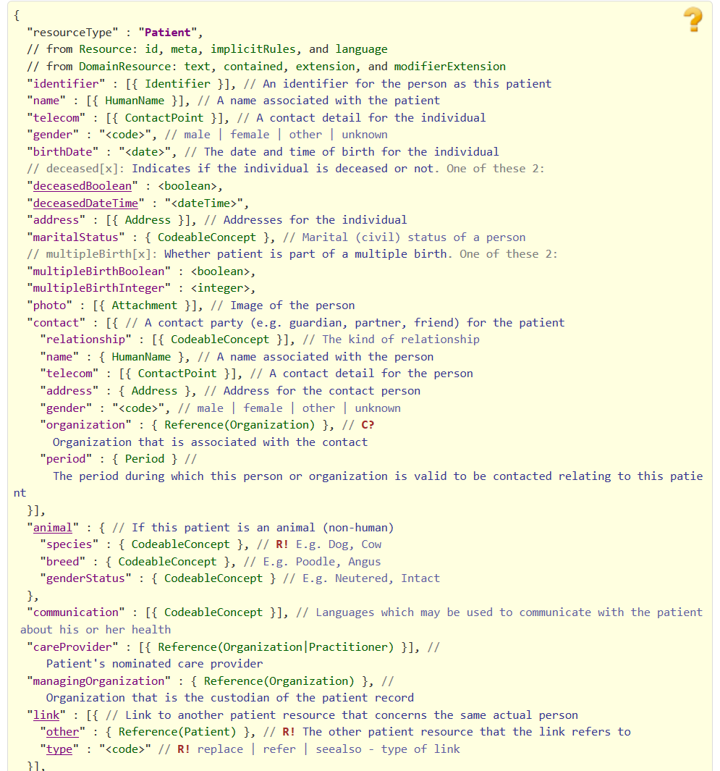
Resource Definitions

Slide 43
Web of resources
Location
Lab
Report
Related
Person
Patient
Practitioner
Notes:
Steve ballmer – It’s all about the developers

Slide 44
References
Resources are independent – don’t need to other resources to correctly interpret a resource
But resources reference each other extensively to form a web of information
Need to resolve references to fully understand the data
Reference is relative to server base URL
<Procedure xmlns="http://hl7.org/fhir">
<subject>
<reference value="Patient/23"/>
</subject>
…

Slide 45
Rules for references
References can be relative or absolute
References don’t have to be to the same server
Server does not have to enforce integrity
Clients need to cater for broken links
Targets can be ‘contained’ in the resource:
<Procedure xmlns="http://hl7.org/fhir">
<contained>
<Patient id="pat">
</Patient>
</contained>
<subject>
<reference value="#pat"/>
</subject>

Slide 46
Narrative
All resources carry an html representation of their content
It’s a clinical safety issue
The receiver has a fall back option if the system is not sure it fully understands the content
It is not mandatory, but SHOULD be present
In a closed eco-system, with extremely tight control and strong conformance testing, it may not be necessary
But things often change over time
So using narrative is highly recommended
Saves a lot of money downstream from the author

Slide 47
Narrative XHTML
Narrative is XHTML. Formatting allowed:
Tables, lists, divs, spans
Bold, Italics, styles etc
E.g. all static content
Features not allowed:
Objects, scripts, forms – any active content
Links, Stylesheets, iframes – web context
Local storage, Microdata (no active content)
Concerns are security and clinical safety

Slide 48
The Case for Extensions
Extensions are a problem
Engineering – not handled by CASE
Poorly described and carelessly done
W3C rules: must interoperate without extensions
This is not possible in healthcare
Choice – design for absolutely everything or allow extensions

Slide 49
Extensions
FHIR has a standard extension framework
Every FHIR element can be extended
Every extension has:
Reference to a computable definition
Value – from a set of known types
Every system can read, write, store and exchange all legal extensions
All extensions are valid by schema etc.

Slide 50
No pain…
Extensions are built into the wire format & handled by CASE tools
All conformant systems can “handle” any possible extension - Just a bucket of “other stuff”
Extensions rendered in human readable portion
Notes:
Recipient must be able to know about these in the instance
Avoid modifier extensions -

Slide 51
Governing Extensions
Extensions are not a silver bullet
FHIR has a sliding scale governance for extensions
Local Projects
Domain standards (e.g. Best Practice Cardiology)
National Standards (e.g. Standard Finnish Extensions)
HL7 published extensions (corner cases with international scope)

Slide 52
What’s the goal here?
In most areas of healthcare standards, there is wide variability
Between systems, countries, institutions, clinicians
Choices:
Specification only supports core – no one can use it
Specification adds everything – no one understands it
Specification picks winners – only they can use it
Allow extensions that people can use
Extensions tame the specification

Slide 53
Example Extension
Eye Colour to patient resource:
Need to pick a URL
Need to choose a type
Have to declare and publish the extension (at the URL)
<Patient xmlns="http://hl7.org/fhir">
<extension url="http://acme.org/fhir/patient#eyecolor">
<valueCode value="brown"/>
</extension>
…

Slide 54
Publishing an Extension
Field | Value
Context | The patient resource
Name | Eye Colour
Definition | Eye Colour as chosen by clerical staff based on visual inspection
Requirements | Refer to policy 23B section A.1.2.3
Cardinality | 0..1
Type | String
Binding | Codes: blue, brown, green, mixed, violet
Modifier | false
Constraints
Mappings | .

Slide 55
Profiles & conformance
Notes:
10:15

Slide 56
Introspection Resources
Conformance – a state of system capabilities
Profile – a set of rules about a resource is used
Value set – describes a set of codes that can be used for something

Slide 57
Conformance
How a FHIR system behaves
Can be used for:
Stating how a specific system instance behaves
Defining how a software system is capable of behaving (including configuration options)
Identifying a desired set of behavior (e.g. RFP)
To declare themselves “FHIR Conformant”, a system must publish a Conformance resource
Notes:
Doesn’t have to support XML – is can be json only

Slide 58
Profiles
Document constraints and extensions on one or more resources
Can also define new extensions, search terms, etc.
Looks an awful lot like the definition of the resources themselves
You can download profile XML for all resources
Notes:
Extensions and profiles are a big part of spec – Wednesday Q2 for specific session

Slide 59
Value sets
A list of codes
Define your own, include codes from other code system (e.g. LOINC)
Used to define conformance rules, UI functionality, system capabilities
Functional service built around this

Slide 60
Using Profiles
You can just go ahead and use a resource
No need for a profile
But you can write a profile
Document your usage in detail for partners
You can mark a resource with a profile
It’s just a claim – can test conformance with that
Denormalization for performance

Slide 61
Implementation Guide
How the FHIR capabilities are used to solve a particular problem
Eliminate optionality
Make requirements of systems
Compare Implementations
Systems can interoperate for a particular use case
Can function without it, but much more degenerate

Slide 62
Implementing FHIR

Slide 63
Where can FHIR be used?
Classic in-institution interoperability
Back-end e-business systems (e.g. financial)
Regional Health Information Organizations (RHIO)
National EHR systems
Social Web (Health)
Mobile Applications
Initial
Focus

Slide 64
Architecture
Standalone FHIR Server
A FHIR Server in front of an existing application (e.g. SQL) e.g. OpenMRS
FHIR as front end to an XDS server (“MHD”)
An interface engine that ‘speaks’ FHIR
A tablet/mobile phone application
Communication from application to data providers
Exchange between apps on the device
Web portal uses FHIR to access other systems
Smart-On-FHIR – an EHR plug-in framework

Slide 65
Implementation Assistance
Reference Implementations – object models, parsers, serializers, clients, validators, utilities
Schema, Schematron, Validation Pack
1000’s of examples
Live Servers to test against
http://wiki.hl7.org/index.php?title=Publicly_Available_FHIR_Servers_for_testing
Connectathons

Slide 66
Connectathons
Open invitation to any interested party to come and write software that exchanges FHIR resources
Always hold one before HL7 meetings (last week) + Others by invitation
Mix of skills
Newbies (“where is the spec?”)
Old hands who’ve been to every connectathon
Experiment with new features
We have a virtual connectathon all the time…

Slide 67
Community Development
Storming
Pre-draft, governance, community engagement
DSTU 1 & 2 development
Make breaking changes without counting cost
Norming
DSTU 2 -> Normative Core content
Count cost of breaking change
Conforming
Increase amount of normative content
No breaking change at all in normative content
New content goes through same process

Slide 68
FHIR Manifesto
Focus on Implementers
Target support for common scenarios
Leverage cross-industry web technologies
Require human readability as base level of interoperability
Make content freely available
Support multiple paradigms & architectures
Demonstrate best practice governance

Slide 69
Discussion / Questions

